Slide 1
CSE 207: Data Structures and Algorithms-II (Part 1)
Instructor
Dr Md Monirul Islam

Slide 2
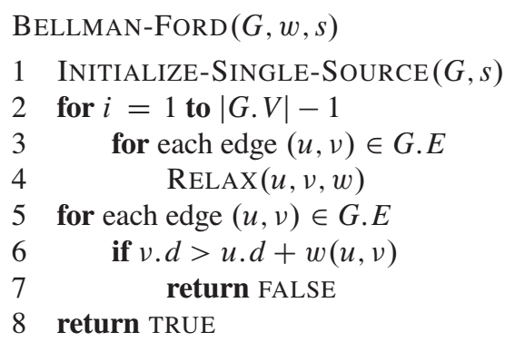
Bellman-Ford Algorithm

Slide 3
Simulation of Bellman-Ford Algorithm
t
5
x
∞
-2
∞
6
s
8
-3
0
7
-4
7
2
∞
∞
9
y
z
Initialization
We process edges in the order: (t, x), (t, y), (t, z), (x, t), (y, x), (y, z), (z, x), (z, s), (s, t), (s, y)

Slide 4
Simulation of Bellman-Ford Algorithm
t
5
x
t
5
x
∞
-2
∞
6
-2
∞
6
6
s
s
8
-3
8
-3
0
7
0
7
-4
-4
7
2
2
7
∞
∞
7
∞
9
9
y
z
y
z
Initialization
Iteration 1
We process edges in the order: (t, x), (t, y), (t, z), (x, t), (y, x), (y, z), (z, x), (z, s), (s, t), (s, y)

Slide 5
Simulation of Bellman-Ford Algorithm
t
5
x
t
5
x
t
5
x
∞
-2
∞
6
-2
∞
6
-2
4
6
6
6
s
s
s
8
-3
8
-3
8
-3
0
7
0
7
0
7
-4
-4
-4
7
2
2
2
7
7
∞
∞
7
∞
7
2
9
9
9
y
z
y
z
y
z
Initialization
Iteration 1
Iteration 2
How changes: x=11 z=2 x=4
We process edges in the order: (t, x), (t, y), (t, z), (x, t), (y, x), (y, z), (z, x), (z, s), (s, t), (s, y)

Slide 6
Simulation of Bellman-Ford Algorithm
t
5
x
t
5
x
t
5
x
6
∞
6
4
2
-2
4
-2
-2
6
6
6
s
s
s
-3
-3
8
-3
0
8
7
0
8
7
0
7
-4
-4
-4
2
2
7
2
7
7
7
∞
7
2
7
2
9
9
9
y
z
y
z
y
z
Iteration 1
Iteration 2
Iteration 3
How changes: t=2
We process edges in the order: (t, x), (t, y), (t, z), (x, t), (y, x), (y, z), (z, x), (z, s), (s, t), (s, y)

Slide 7
Simulation of Bellman-Ford Algorithm
t
5
x
t
5
x
t
5
x
6
4
2
-2
4
2
-2
4
-2
6
6
6
s
s
s
-3
8
-3
8
-3
0
8
7
0
7
0
7
-4
-4
-4
2
7
2
2
7
7
7
2
7
2
7
-2
9
9
9
y
z
y
z
y
z
Iteration 2
Iteration 3
Iteration 4
How changes: z=-2
We process edges in the order: (t, x), (t, y), (t, z), (x, t), (y, x), (y, z), (z, x), (z, s), (s, t), (s, y)

Slide 8
Simulation of Bellman-Ford Algorithm: Cycle Detection
t
-5
x
∞
2
∞
6
s
8
3
0
7
∞
y
Initialization
We process edges in the order: (t, x), (x, t), (y, t), (y, x), (s, t), (s, y)

Slide 9
Simulation of Bellman-Ford Algorithm: Cycle Detection
t
-5
x
t
-5
x
∞
2
∞
6
2
∞
6
6
s
s
8
3
8
3
0
0
7
7
∞
7
y
y
Initialization
Iteration 1
How changes: t=6 y=7
We process edges in the order: (t, x), (x, t), (y, t), (y, x), (s, t), (s, y)

Slide 10
Simulation of Bellman-Ford Algorithm: Cycle Detection
t
-5
x
t
-5
x
t
-5
x
∞
2
∞
6
2
∞
1
2
-1
6
6
6
s
s
s
3
3
8
3
0
8
0
8
0
7
7
7
∞
7
7
y
y
y
Initialization
Iteration 1
Iteration 2
How changes: x=-1 t=1
We process edges in the order: (t, x), (x, t), (y, t), (y, x), (s, t), (s, y)

Slide 11
Simulation of Bellman-Ford Algorithm: Cycle Detection
t
-5
x
t
-5
x
t
-5
x
6
2
∞
1
2
-1
-2
2
-4
6
6
6
s
s
s
3
8
3
8
3
0
8
0
0
7
7
7
7
7
7
y
y
y
Iteration 1
Iteration 2
Iteration 3
How changes: x=-4 t=-2
We process edges in the order: (t, x), (x, t), (y, t), (y, x), (s, t), (s, y)

Slide 12
Simulation of Bellman-Ford Algorithm: Cycle Detection
t
-5
x
t
-5
x
t
-5
x
6
2
∞
1
2
-1
-2
2
-4
6
6
6
s
s
s
3
8
3
8
3
0
8
0
0
Main iterations are completed!
7
7
7
7
7
7
y
y
y
Iteration 1
Iteration 2
Iteration 3
How changes: x=-4 t=-2
We process edges in the order: (t, x), (x, t), (y, t), (y, x), (s, t), (s, y)

Slide 13
Simulation of Bellman-Ford Algorithm: Cycle Detection
t
-5
x
t
-5
x
-2
2
-7
-2
2
-4
6
6
s
s
8
3
8
3
0
Cycle Detection iteration
0
7
7
7
7
y
y
Extra Iteration for Cycle Detection
Iteration 3
How changes: x=-7
We process edges in the order: (t, x), (x, t), (y, t), (y, x), (s, t), (s, y)

Slide 14
Simulation of Bellman-Ford Algorithm: Cycle Detection
t
-5
x
t
-5
x
-2
2
-7
-2
2
-4
6
6
s
s
8
3
8
3
0
0
Detected!!
7
7
7
7
y
y
Extra Iteration for Cycle Detection
Iteration 3
How changes: x=-7
We process edges in the order: (t, x), (x, t), (y, t), (y, x), (s, t), (s, y)

Slide 15
Bellman-Ford Algorithm Correctly Finds Shortest Paths
t
5
x
t
5
x
t
5
x
6
4
2
-2
4
2
-2
4
t
x
-2
6
6
6
2
-2
4
s
s
s
-3
8
-3
8
-3
0
8
7
0
7
0
7
s
-4
-4
-4
-3
0
2
7
2
2
-4
7
7
2
7
2
7
7
2
7
-2
9
9
9
7
-2
y
z
y
z
y
z
y
z
Iteration 2
Iteration 3
Iteration 4
Shortest Paths tree

Slide 16
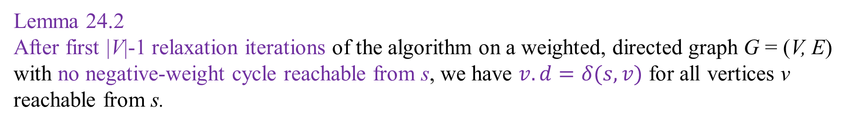
Bellman-Ford Algorithm Correctly Finds Shortest Paths
Lemma 24.2
After first |V|-1 relaxation iterations of the algorithm on a weighted, directed graph G = (V, E) with no negative-weight cycle reachable from s, we have $v.d=δ(s,v)$ for all vertices v reachable from s.

Slide 17
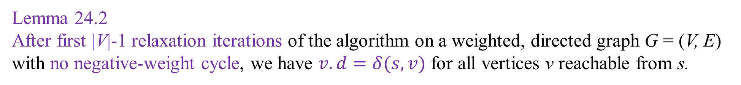
Bellman-Ford Algorithm Correctly Finds Shortest Paths
Lemma 24.2
After first |V|-1 relaxation iterations of the algorithm on a weighted, directed graph G = (V, E) with no negative-weight cycle, we have $v.d=δ(s,v)$ for all vertices v reachable from s.
Proof of Lemma 24.2
p = <v₀, v₁, . . ., v_{k} > is a shortest path from s = v₀ to v = v_{k}
p is a simple path => p has at most |V|-1 edges
k<=|V|-1
v₁
v₂
v₃
v_{k-1}
v=v_{k}
s=v₀
0
0
0
0
0
0

Slide 18
Bellman-Ford Algorithm Correctly Finds Shortest Paths
Lemma 24.2
After first |V|-1 relaxation iterations of the algorithm on a weighted, directed graph G = (V, E) with no negative-weight cycle, we have $v.d=δ(s,v)$ for all vertices v reachable from s.
Proof of Lemma 24.2
The algorithm relaxes all edges |V|-1 times
Therefore, edge (v₀, v₁) is relaxed at iteration 1
edge (v₁, v₂) is relaxed at iteration 2
edge (v₂, v₃) is relaxed at iteration 3
k<=|V|-1
v₁
v₂
v₃
v_{k-1}
v=v_{k}
s=v₀
0
0
0
0
0
0
Relaxation
Iteration 1
Relaxation
Iteration 2
Relaxation
Iteration 3

Slide 19
Bellman-Ford Algorithm Correctly Finds Shortest Paths
Lemma 24.2
After first |V|-1 relaxation iterations of the algorithm on a weighted, directed graph G = (V, E) with no negative-weight cycle, we have $v.d=δ(s,v)$ for all vertices v reachable from s.
Proof of Lemma 24.2
The algorithm relaxes all edges |V|-1 times
Therefore, edge (v_{i-1}, v_{i}) is relaxed at iteration i; for i = 1 to k
k<=|V|-1
v₁
v₂
v₃
v_{k-1}
v=v_{k}
s=v₀
0
0
0
0
0
0
Relaxation
Iteration 1
Relaxation
Iteration 2
Relaxation
Iteration 3
Relaxation
Iteration k

Slide 20
Bellman-Ford Algorithm Correctly Finds Shortest Paths
Lemma 24.2
After first |V|-1 relaxation iterations of the algorithm on a weighted, directed graph G = (V, E) with no negative-weight cycle, we have $v.d=δ(s,v)$ for all vertices v reachable from s.
Proof of Lemma 24.2
Path relaxation property says that $v.d=v_{k}.d=δ(s,v_{k})=δ(s,v)$
k<=|V|-1
v₁
v₂
v₃
v_{k-1}
v=v_{k}
s=v₀
0
0
0
0
0
0
Relaxation
Iteration 1
Relaxation
Iteration 2
Relaxation
Iteration 3
Relaxation
Iteration k

Slide 21
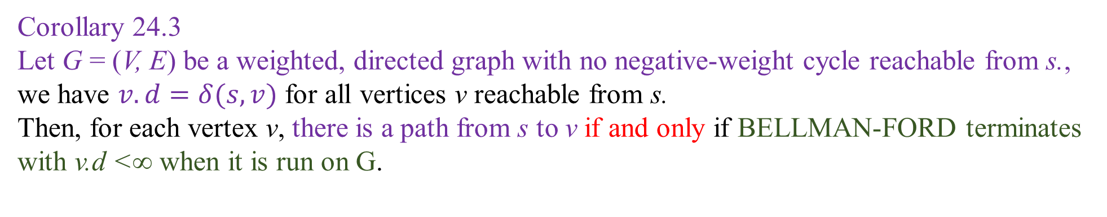
Bellman-Ford Algorithm Correctly Finds Shortest Paths
Corollary 24.3
Let G = (V, E) be a weighted, directed graph with no negative-weight cycle reachable from s., we have $v.d=δ(s,v)$ for all vertices v reachable from s.
Then, for each vertex v, there is a path from s to v if and only if BELLMAN-FORD terminates with v.d <∞ when it is run on G.

Slide 22
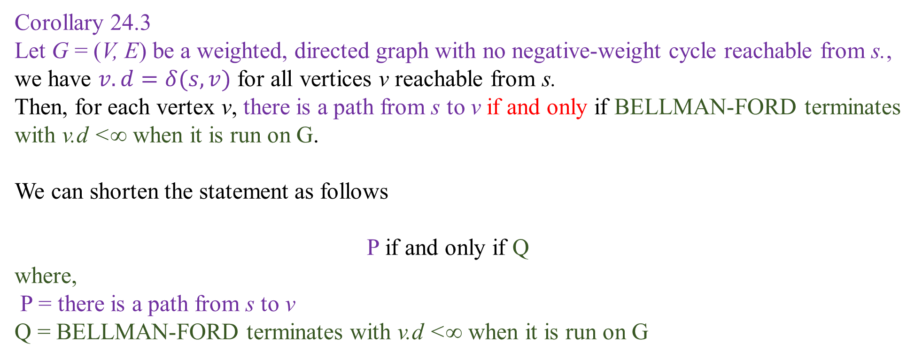
Bellman-Ford Algorithm Correctly Finds Shortest Paths
Corollary 24.3
Let G = (V, E) be a weighted, directed graph with no negative-weight cycle reachable from s., we have $v.d=δ(s,v)$ for all vertices v reachable from s.
Then, for each vertex v, there is a path from s to v if and only if BELLMAN-FORD terminates with v.d <∞ when it is run on G.
We can shorten the statement as follows
P if and only if Q
where,
P = there is a path from s to v
Q = BELLMAN-FORD terminates with v.d <∞ when it is run on G

Slide 23
Bellman-Ford Algorithm Correctly Finds Shortest Paths
Proof of Corollary 24.3
If P, then Q
where,
P = there is a path from s to v
Q = BELLMAN-FORD terminates with v.d <∞ when it is run on G

Slide 24
Bellman-Ford Algorithm Correctly Finds Shortest Paths
Proof of Corollary 24.3
If P, then Q
As there is a path from s to v, there is a shortest too. => δ(s,v) is finite
s
Shortest path to v
δ(s,v) is finite
v

Slide 25
Bellman-Ford Algorithm Correctly Finds Shortest Paths
Proof of Corollary 24.3
If P, then Q
As there is a path from s to v, there is a shortest too. => δ(s,v) is finite
Lemma 24.2 tells that line 2-4 sets v.d = δ(s,v) <∞
s
Shortest path to v
δ(s,v) is finite
v

Slide 26
Bellman-Ford Algorithm Correctly Finds Shortest Paths
Proof of Corollary 24.3
If P, then Q
As there is a path from s to v, there is a shortest too. => δ(s,v) is finite
Lemma 24.2 tells that line 2-4 sets v.d = δ(s,v) <∞
Therefore, v.d <∞
s
Shortest path to v
δ(s,v) is finite
v

Slide 27
Bellman-Ford Algorithm Correctly Finds Shortest Paths
Proof of Corollary 24.3
If Q, then P
where,
P = there is a path from s to v
Q = BELLMAN-FORD terminates with v.d <∞ when it is run on G

Slide 28
Bellman-Ford Algorithm Correctly Finds Shortest Paths
Proof of Corollary 24.3
If Q, then P
Initially all v.d = ∞
We gradually decrease v.d and set v.π by relaxation if there is a path from s to v

Slide 29
Bellman-Ford Algorithm Correctly Finds Shortest Paths
Proof of Corollary 24.3
If Q, then P
Initially all v.d = ∞
We gradually decrease v.d and set v.π by relaxation if there is a path from s to v
G_{π} forms and it is shortest path tree rooted at s.
Therefore, there is a path from s to v in G_{π}
t
x
2
-2
4
s
-3
0
-4
7
2
7
-2
y
z
Shortest Paths tree (G_{π} )

Slide 30
Bellman-Ford Algorithm Correctly Finds Shortest Paths
Proof of Corollary 24.3
If Q, then P
Initially all v.d = ∞
We gradually decrease v.d and set v.π by relaxation if there is a path from s to v
G_{π} forms and it is shortest path tree rooted at s.
Therefore, there is a path from s to v in G_{π}
Edges of this path are also in G
Therefore, there is a path from s to v in G also.
t
5
x
∞
-2
∞
t
x
2
-2
4
6
s
8
-3
s
0
7
-3
-4
0
-4
7
2
2
7
∞
∞
7
-2
9
y
z
y
z
Graph, G
Shortest Paths tree (G_{π} )

Slide 31
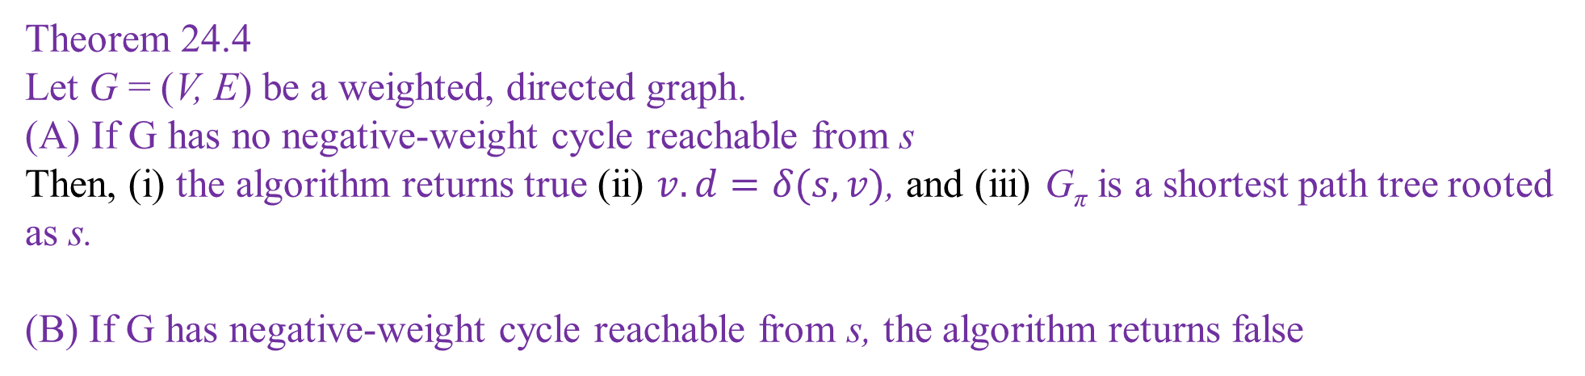
Bellman-Ford Algorithm Correctly Finds Shortest Paths
Theorem 24.4
Let G = (V, E) be a weighted, directed graph.
(A) If G has no negative-weight cycle reachable from s Then, (i) the algorithm returns true (ii) $v.d=δ(s,v)$, and (iii) G_{π} is a shortest path tree rooted as s.
(B) If G has negative-weight cycle reachable from s, the algorithm returns false

Slide 32
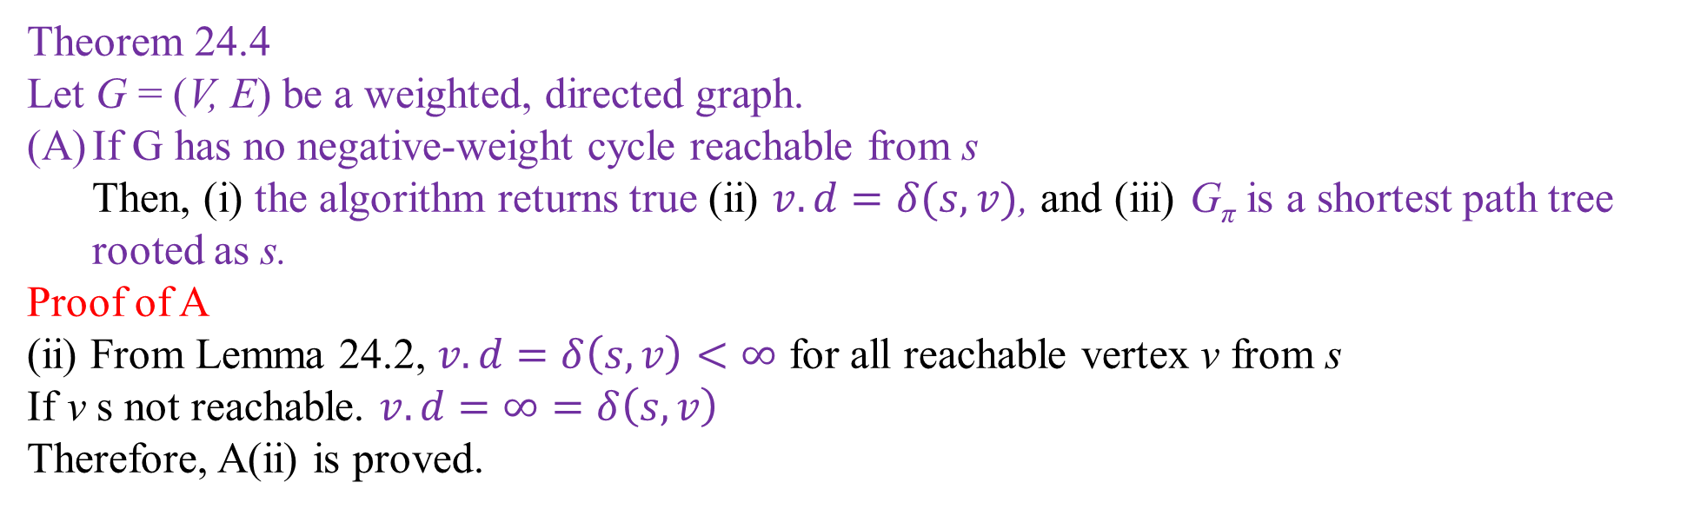
Bellman-Ford Algorithm Correctly Finds Shortest Paths
Theorem 24.4
Let G = (V, E) be a weighted, directed graph.
If G has no negative-weight cycle reachable from s Then, (i) the algorithm returns true (ii) $v.d=δ(s,v)$, and (iii) G_{π} is a shortest path tree rooted as s.
Proof of A
(ii) From Lemma 24.2, $v.d=δ\left(s,v\right)<∞$ for all reachable vertex v from s
If v s not reachable. $v.d=∞=δ\left(s,v\right)$
Therefore, A(ii) is proved.

Slide 33
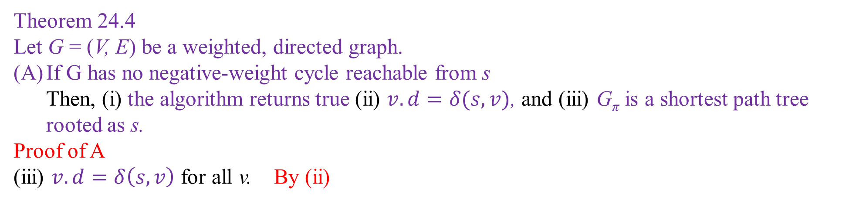
Bellman-Ford Algorithm Correctly Finds Shortest Paths
Theorem 24.4
Let G = (V, E) be a weighted, directed graph.
If G has no negative-weight cycle reachable from s Then, (i) the algorithm returns true (ii) $v.d=δ(s,v)$, and (iii) G_{π} is a shortest path tree rooted as s.
Proof of A
(iii) $v.d=δ\left(s,v\right)$ for all v. By (ii)

Slide 34
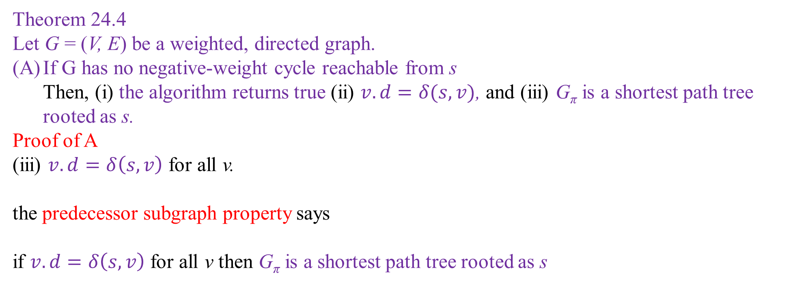
Bellman-Ford Algorithm Correctly Finds Shortest Paths
Theorem 24.4
Let G = (V, E) be a weighted, directed graph.
If G has no negative-weight cycle reachable from s Then, (i) the algorithm returns true (ii) $v.d=δ(s,v)$, and (iii) G_{π} is a shortest path tree rooted as s.
Proof of A
(iii) $v.d=δ\left(s,v\right)$ for all v.
the predecessor subgraph property says
if $v.d=δ\left(s,v\right)$ for all v then G_{π} is a shortest path tree rooted as s

Slide 35
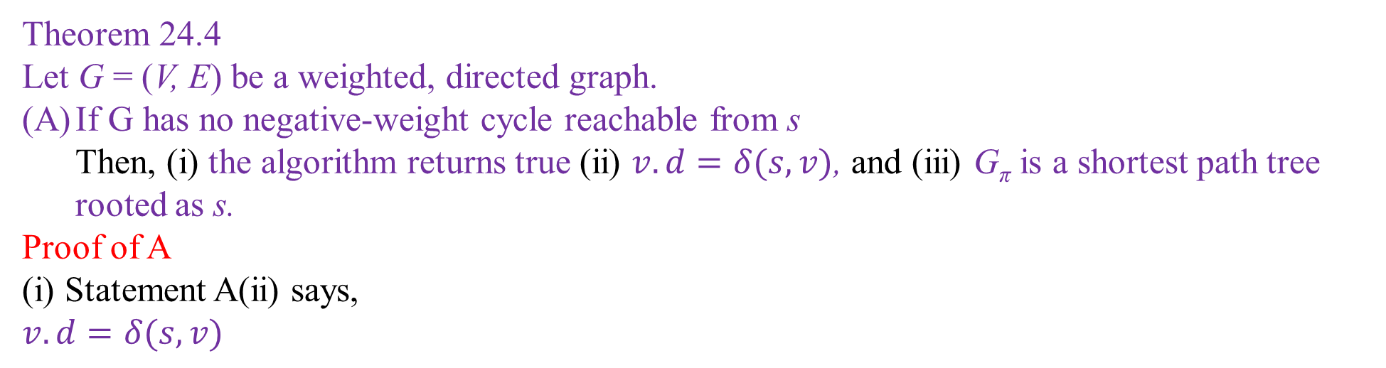
Bellman-Ford Algorithm Correctly Finds Shortest Paths
Theorem 24.4
Let G = (V, E) be a weighted, directed graph.
If G has no negative-weight cycle reachable from s Then, (i) the algorithm returns true (ii) $v.d=δ(s,v)$, and (iii) G_{π} is a shortest path tree rooted as s.
Proof of A
(i) Statement A(ii) says,
$$v.d=δ(s,v)$$

Slide 36
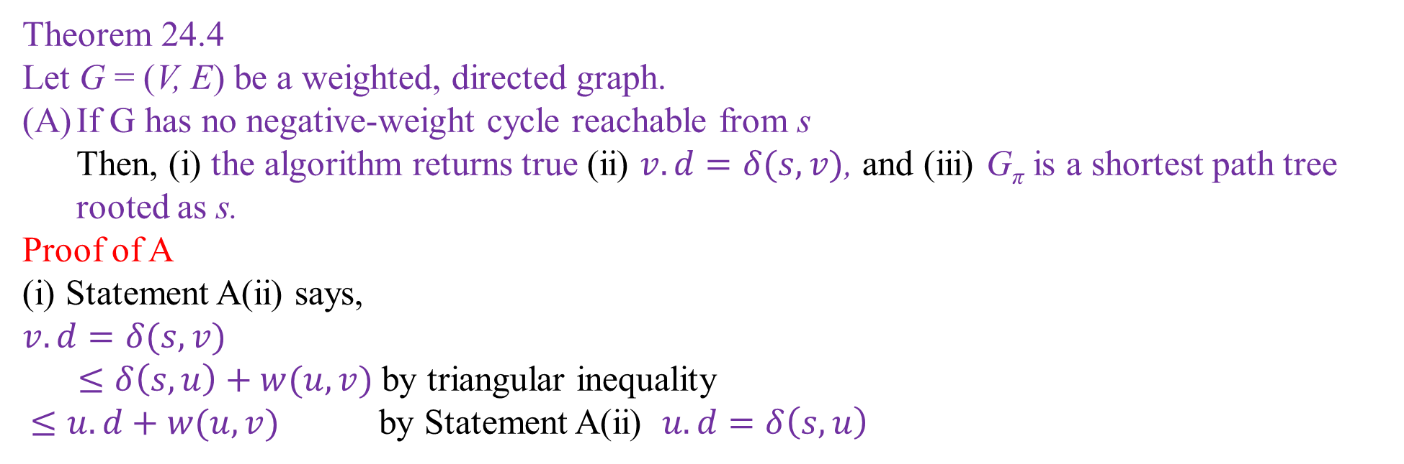
Bellman-Ford Algorithm Correctly Finds Shortest Paths
Theorem 24.4
Let G = (V, E) be a weighted, directed graph.
If G has no negative-weight cycle reachable from s Then, (i) the algorithm returns true (ii) $v.d=δ(s,v)$, and (iii) G_{π} is a shortest path tree rooted as s.
Proof of A
(i) Statement A(ii) says,
$$v.d=δ(s,v)$$
$≤δ\left(s,u\right)+w(u,v)$ by triangular inequality
$≤u.d+w(u,v)$ by Statement A(ii) $u.d=δ\left(s,u\right)$

Slide 37
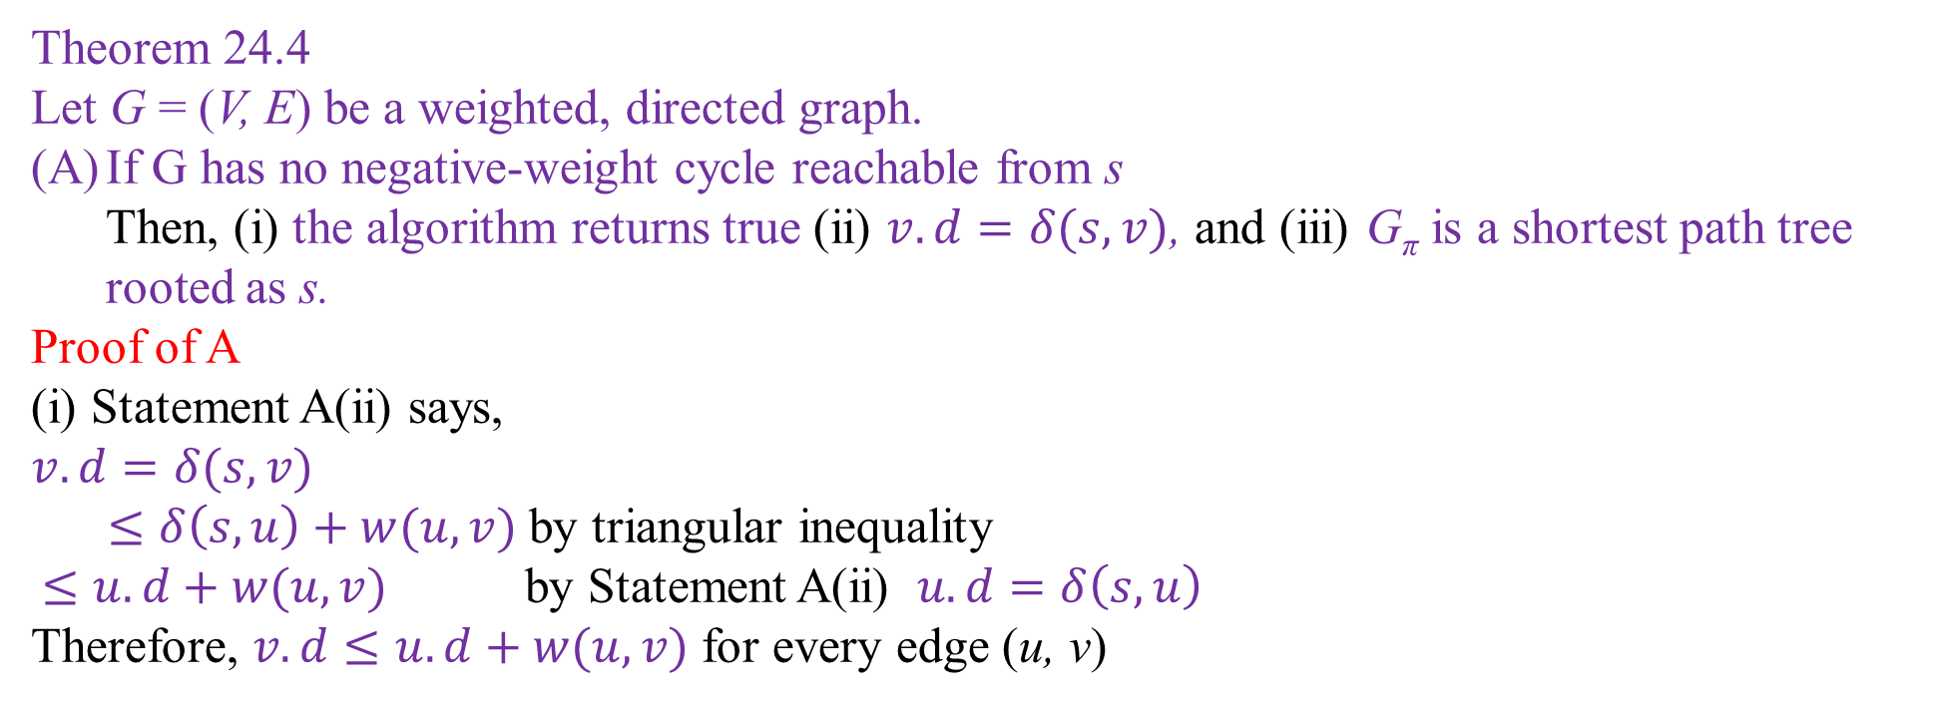
Bellman-Ford Algorithm Correctly Finds Shortest Paths
Theorem 24.4
Let G = (V, E) be a weighted, directed graph.
If G has no negative-weight cycle reachable from s Then, (i) the algorithm returns true (ii) $v.d=δ(s,v)$, and (iii) G_{π} is a shortest path tree rooted as s.
Proof of A
(i) Statement A(ii) says,
$$v.d=δ(s,v)$$
$≤δ\left(s,u\right)+w(u,v)$ by triangular inequality
$≤u.d+w(u,v)$ by Statement A(ii) $u.d=δ\left(s,u\right)$
Therefore, $v.d≤u.d+w(u,v)$ for every edge (u, v)

Slide 38
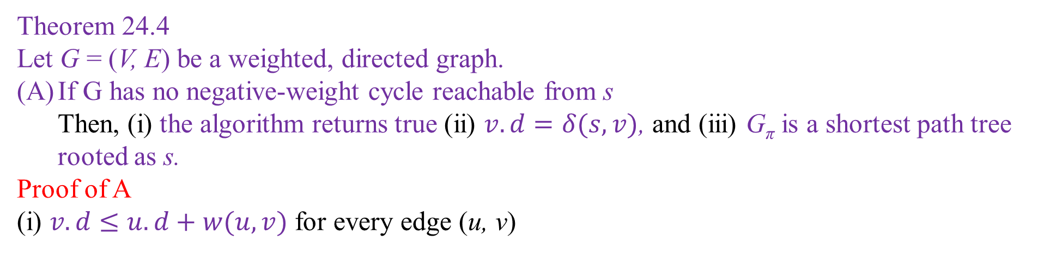
Bellman-Ford Algorithm Correctly Finds Shortest Paths
Theorem 24.4
Let G = (V, E) be a weighted, directed graph.
If G has no negative-weight cycle reachable from s Then, (i) the algorithm returns true (ii) $v.d=δ(s,v)$, and (iii) G_{π} is a shortest path tree rooted as s.
Proof of A
(i) $v.d≤u.d+w(u,v)$ for every edge (u, v)

Slide 39

Bellman-Ford Algorithm Correctly Finds Shortest Paths
Theorem 24.4
Let G = (V, E) be a weighted, directed graph.
If G has no negative-weight cycle reachable from s Then, (i) the algorithm returns true (ii) $v.d=δ(s,v)$, and (iii) G_{π} is a shortest path tree rooted as s.
Proof of A
(i) $v.d≤u.d+w(u,v)$ for every edge (u, v)
The algorithm will NEVER returns FALSE

Slide 40
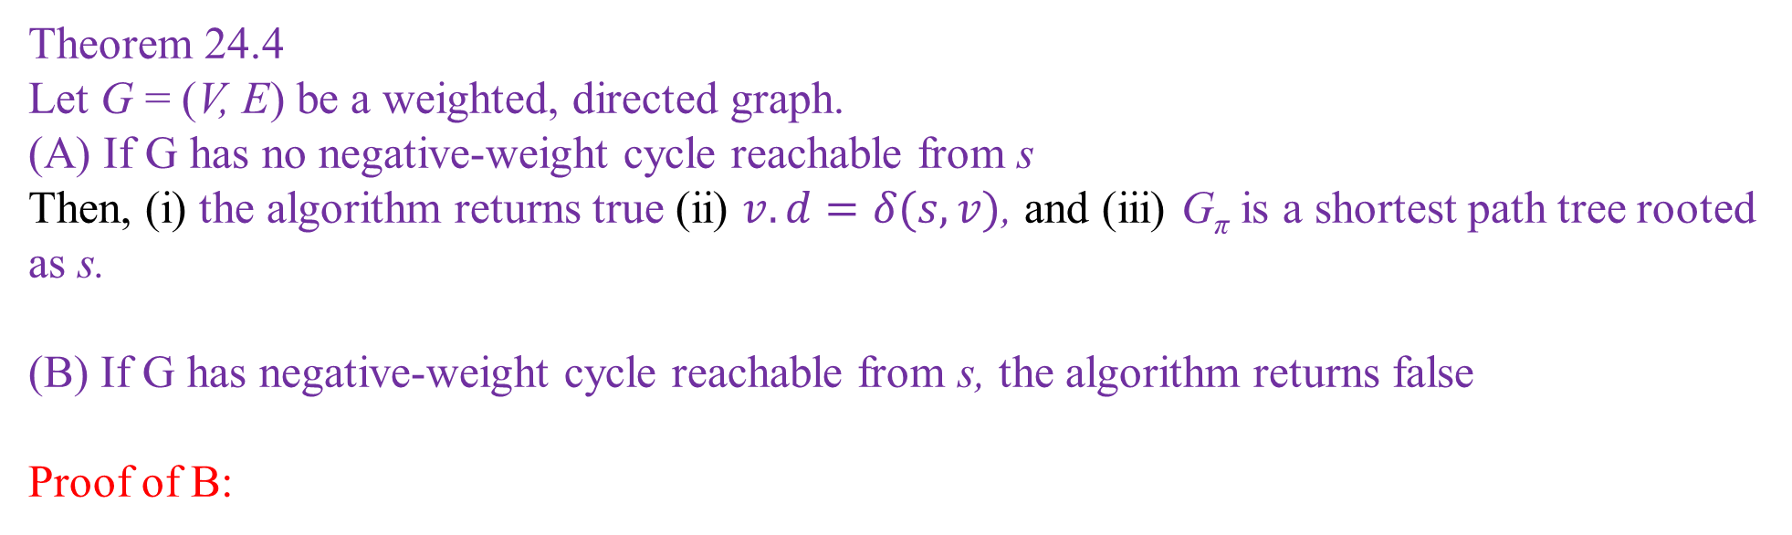
Bellman-Ford Algorithm Correctly Finds Shortest Paths
Theorem 24.4
Let G = (V, E) be a weighted, directed graph.
(A) If G has no negative-weight cycle reachable from s Then, (i) the algorithm returns true (ii) $v.d=δ(s,v)$, and (iii) G_{π} is a shortest path tree rooted as s.
(B) If G has negative-weight cycle reachable from s, the algorithm returns false
Proof of B:

Slide 41
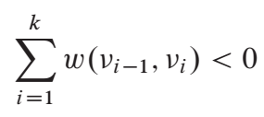
Bellman-Ford Algorithm Correctly Finds Shortest Paths
Proof of B:
Assume we have negative weight cycle, c = <v₀, v₁, . . ., v_{k} >, where v₀ = v_{k}
As c is a negative weight cycle,
0
c
0
v_{k-1}
v₁
0
v_{k}
0
0
v₀

Slide 42
Bellman-Ford Algorithm Correctly Finds Shortest Paths
Proof of B:
Assume for the contradiction, algorithm returns TRUE
0
c
0
v_{k-1}
v₁
0
v_{k}
0
0
v₀

Slide 43
Bellman-Ford Algorithm Correctly Finds Shortest Paths
Proof of B:
Assume for the contradiction, algorithm returns TRUE
0
c
0
v_{k-1}
v₁
0
v_{k}
0
0
v₀
This will never execute

Slide 44
Bellman-Ford Algorithm Correctly Finds Shortest Paths
Proof of B:
Assume for the contradiction, algorithm returns TRUE
0
c
0
v_{k-1}
v₁
0
v_{k}
0
0
This is false always
v₀
This will never execute

Slide 45
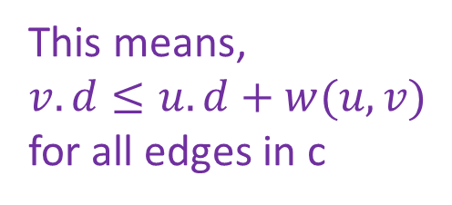
Bellman-Ford Algorithm Correctly Finds Shortest Paths
Proof of B:
Assume for the contradiction, algorithm returns TRUE
0
c
This means,
$v.d≤u.d+w(u,v)$ for all edges in c
0
v_{k-1}
v₁
0
v_{k}
0
0
This is false always
v₀
This will never execute

Slide 46
Bellman-Ford Algorithm Correctly Finds Shortest Paths
Proof of B:
Assume for the contradiction, algorithm returns TRUE
for all i = 0 to k
0
c
This means,
$v.d≤u.d+w(u,v)$ for all edges in c
0
v_{k-1}
v₁
0
v_{k}
0
0
v₀

Slide 47
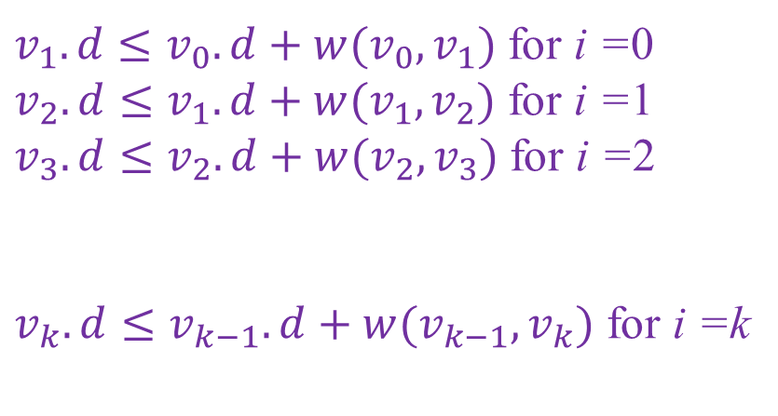
Bellman-Ford Algorithm Correctly Finds Shortest Paths
Proof of B:
Assume for the contradiction, algorithm returns TRUE
$v_{1}.d≤v_{0}.d+w(v_{0},v_{1})$ for i =0
$v_{2}.d≤v_{1}.d+w(v_{1},v_{2})$ for i =1
$v_{3}.d≤v_{2}.d+w(v_{2},v_{3})$ for i =2
$v_{k}.d≤v_{k−1}.d+w(v_{k−1},v_{k})$ for i =k
0
c
0
v_{k-1}
v₁
0
v_{k}
0
0
v₀

Slide 48
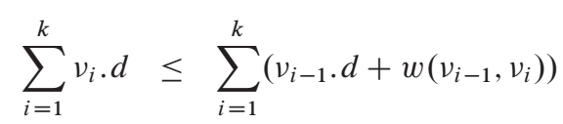
Bellman-Ford Algorithm Correctly Finds Shortest Paths
Proof of B:
Assume for the contradiction, algorithm returns TRUE
$v_{1}.d≤v_{0}.d+w(v_{0},v_{1})$ for i =0
$v_{2}.d≤v_{1}.d+w(v_{1},v_{2})$ for i =1
$v_{3}.d≤v_{2}.d+w(v_{2},v_{3})$ for i =2
$v_{k}.d≤v_{k−1}.d+w(v_{k−1},v_{k})$ for i =k
0
c
0
v_{k-1}
v₁
0
v_{k}
0
0
v₀
Summing up all, we get,

Slide 49
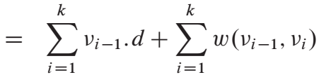
Bellman-Ford Algorithm Correctly Finds Shortest Paths
Proof of B:
Assume for the contradiction, algorithm returns TRUE
0
c
0
v_{k-1}
v₁
0
v_{k}
0
0
v₀

Slide 50
Bellman-Ford Algorithm Correctly Finds Shortest Paths
Proof of B:
Assume for the contradiction, algorithm returns TRUE
0
c
0
v_{k-1}
v₁
0
v_{k}
0
0
v₀
But, v₀ = v_{k},

Slide 51
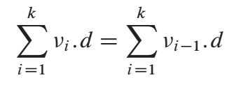
Bellman-Ford Algorithm Correctly Finds Shortest Paths
Proof of B:
Assume for the contradiction, algorithm returns TRUE
0
c
0
v_{k-1}
v₁
0
v_{k}
0
0
v₀
But, v₀ = v_{k}, therefore,

Slide 52
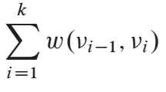
Bellman-Ford Algorithm Correctly Finds Shortest Paths
Proof of B:
Assume for the contradiction, algorithm returns TRUE
0
c
0
v_{k-1}
v₁
0
v_{k}
0
0
v₀
We get,
≥0

Slide 53
Bellman-Ford Algorithm Correctly Finds Shortest Paths
Proof of B:
Assume for the contradiction, algorithm returns TRUE
0
c
0
v_{k-1}
v₁
0
v_{k}
0
0
v₀
We get,
≥0
Weight of c is non-negative!! Contradiction!!

Slide 54
Bellman-Ford Algorithm Correctly Finds Shortest Paths
Proof of B:
Assume for the contradiction, algorithm returns TRUE
0
c
This assumption was wrong
v_{k-1}
v₁
0
0
v_{k}
0
0
v₀

Slide 55
Bellman-Ford Algorithm Correctly Finds Shortest Paths
Proof of B:
We proved that algorithm returns FALSE if negative-weight cycle exists.
0
c
0
v_{k-1}
v₁
0
v_{k}
0
0
v₀

Slide 56





Complexity of Bellman-Ford Algorithm
$$O(V)$$
$$O(V)$$
$$O(E)$$
$$O(1)$$
$$O(E)$$

Slide 57

Complexity of Bellman-Ford Algorithm
$$O(V)$$
$$O(V)$$
$$O(E)$$
$$O(1)$$
$$O(E)$$
Total complexity $O\left(VE\right)$

Slide 58
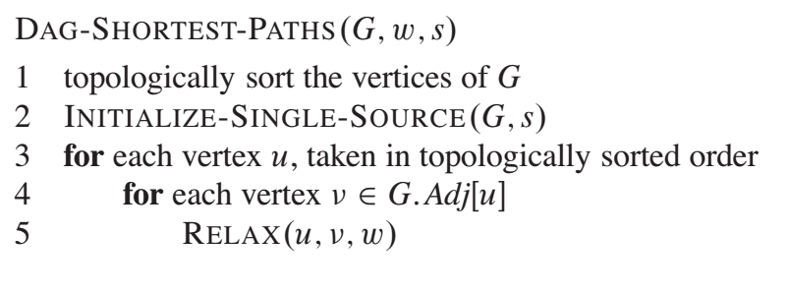
SSSP for DAG

Slide 59
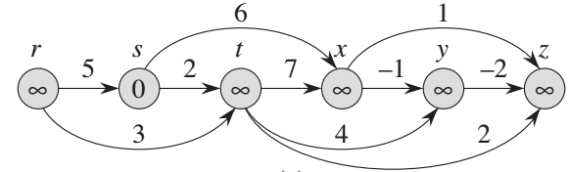
Simulation of SSSP for DAG

Slide 60
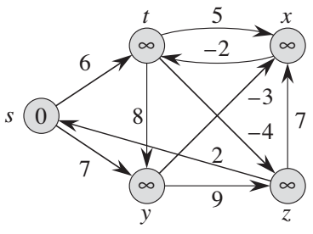
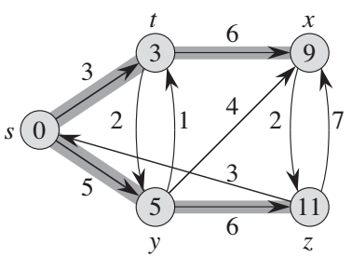
t
x
h
i
t
x
2
6
9
∞
∞
6
9
3
3
3
-8
3
3
s
∞
s
4
0
j
0
2
1
2
7
3
5
5
5
6
11
5
6
11
y
z
y
z

Slide 61
t
x
h
i
t
5
x
2
6
9
∞
∞
∞
3
∞
-2
3
-8
3
6
s
∞
s
8
-3
0
j
0
7
-4
2
5
7
5
6
11
∞
∞
9
y
z
y
z

Slide 62
End of Slides

Slide 63
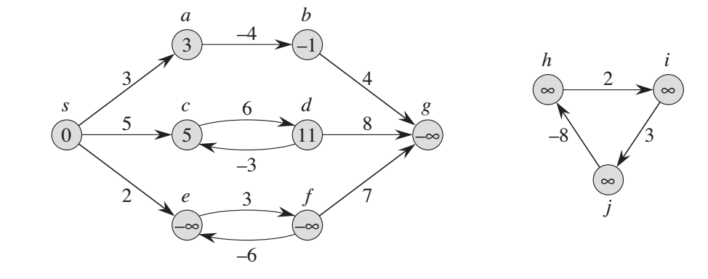
Negative Weight Edges

Slide 64
a
b
-4
-1
3
4
3
s
c
6
d
g
h
i
5
8
2
0
5
11
- ∞
∞
∞
-3
3
2
f
-8
e
3
7
∞
- ∞
- ∞
j
-6

Slide 65
a
b
-4
3
-1
4
3
s
c
6
d
g
h
i
5
8
∞
2
∞
0
5
11
- ∞
-3
3
-8
2
e
3
f
7
∞
- ∞
- ∞
j
-6

